Slide 1
MACHINE LEARNING
Session – 8
Date – 05th June, 2022

Slide 2
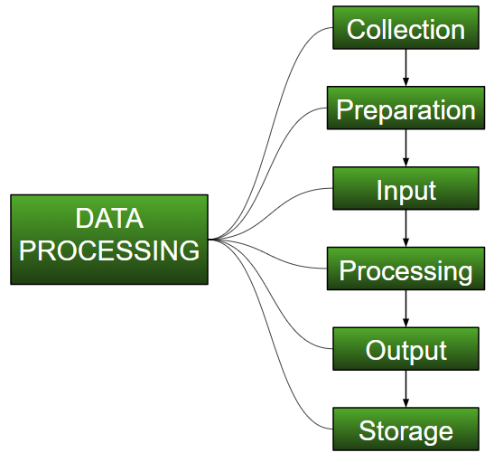
Understanding Data Processing
Data Processing is the task of converting data from a given form to a much more usable and desired form i.e. making it more meaningful and informative. Using Machine Learning algorithms, mathematical modeling, and statistical knowledge, this entire process can be automated. The output of this complete process can be in any desired form like graphs, videos, charts, tables, images, and many more, depending on the task we are performing and the requirements of the machine. This might seem to be simple but when it comes to massive organizations like Twitter, Facebook, Administrative bodies like Parliament, UNESCO, and health sector organizations, this entire process needs to be performed in a very structured manner. So, the steps to perform are as follows:

Slide 3
Collection :
The most crucial step when starting with ML is to have data of good quality and accuracy. Data can be collected from any authenticated source like data.gov.in, Kaggle or UCI Machine Learning Repository: Data Sets. For example, while preparing for a competitive exam, students study from the best study material that they can access so that they learn the best to obtain the best results. In the same way, high-quality and accurate data will make the learning process of the model easier and better and at the time of testing, the model would yield state-of-the-art results. A huge amount of capital, time and resources are consumed in collecting data. Organizations or researchers have to decide what kind of data they need to execute their tasks or research. Example: Working on the Facial Expression Recognizer, needs numerous images having a variety of human expressions. Good data ensures that the results of the model are valid and can be trusted upon.

Slide 4
Preparation :
The collected data can be in a raw form which can’t be directly fed to the machine. So, this is a process of collecting datasets from different sources, analyzing these datasets and then constructing a new dataset for further processing and exploration. This preparation can be performed either manually or from the automatic approach. Data can also be prepared in numeric forms also which would fasten the model’s learning. Example: An image can be converted to a matrix of N X N dimensions, the value of each cell will indicate the image pixel.

Slide 5
Input :
Now the prepared data can be in the form that may not be machine-readable, so to convert this data to the readable form, some conversion algorithms are needed. For this task to be executed, high computation and accuracy is needed. Example: Data can be collected through the sources like MNIST Digit data(images), Twitter comments, audio files, video clips.
Processing :
This is the stage where algorithms and ML techniques are required to perform the instructions provided over a large volume of data with accuracy and optimal computation.

Slide 6
Output :
In this stage, results are procured by the machine in a meaningful manner which can be inferred easily by the user. Output can be in the form of reports, graphs, videos, etc
Storage :
This is the final step in which the obtained output and the data model data and all the useful information are saved for future use.

Slide 7
Why do we need Data Preprocessing?
A real-world data generally contains noises, missing values, and maybe in an unusable format which cannot be directly used for machine learning models. Data preprocessing is required tasks for cleaning the data and making it suitable for a machine learning model which also increases the accuracy and efficiency of a machine learning model.
It involves below steps:
Getting the dataset
Importing libraries
Importing datasets
Finding Missing Data
Encoding Categorical Data
Splitting dataset into training and test set
Feature scaling

Slide 8
1) Get the Dataset

Slide 9
Get the Dataset
To create a machine learning model, the first thing we required is a dataset as a machine learning model completely works on data. The collected data for a particular problem in a proper format is known as the dataset.
Dataset may be of different formats for different purposes, such as, if we want to create a machine learning model for business purpose, then dataset will be different with the dataset required for a liver patient. So each dataset is different from another dataset. To use the dataset in our code, we usually put it into a CSV file. However, sometimes, we may also need to use an HTML or xlsx file.

Slide 10
What is a CSV File?
CSV stands for "Comma-Separated Values" files; it is a file format which allows us to save the tabular data, such as spreadsheets. It is useful for huge datasets and can use these datasets in programs.
Here we will use a demo dataset for data preprocessing, and for practice, it can be downloaded from here, "https://www.superdatascience.com/pages/machine-learning.
For real-world problems, we can download datasets online from various sources such as https://www.kaggle.com/uciml/datasets, https://archive.ics.uci.edu/ml/index.php etc.

Slide 11
2) Importing Libraries

Slide 12
Importing Libraries
In order to perform data preprocessing using Python, we need to import some predefined Python libraries. These libraries are used to perform some specific jobs. There are three specific libraries that we will use for data preprocessing, which are:
Numpy: Numpy Python library is used for including any type of mathematical operation in the code. It is the fundamental package for scientific calculation in Python. It also supports to add large, multidimensional arrays and matrices. So, in Python, we can import it as:
import numpy as nm
Here we have used nm, which is a short name for Numpy, and it will be used in the whole program.
Matplotlib: The second library is matplotlib, which is a Python 2D plotting library, and with this library, we need to import a sub-library pyplot. This library is used to plot any type of charts in Python for the code. It will be imported as below:
import matplotlib.pyplot as mpt
Here we have used mpt as a short name for this library.
Pandas: The last library is the Pandas library, which is one of the most famous Python libraries and used for importing and managing the datasets. It is an open-source data manipulation and analysis library.

Slide 13
3) Importing the Datasets

Slide 14
Importing the Datasets
Now we need to import the datasets which we have collected for our machine learning project. But before importing a dataset, we need to set the current directory as a working directory.

Slide 15
read_csv() function:
Now to import the dataset, we will use read_csv() function of pandas library, which is used to read a csv file and performs various operations on it. Using this function, we can read a csv file locally as well as through an URL.
We can use read_csv function as below:
data_set= pd.read_csv('Dataset.csv')
Here, data_set is a name of the variable to store our dataset, and inside the function, we have passed the name of our dataset. Once we execute the above line of code, it will successfully import the dataset in our code.

Slide 16
Extracting dependent and independent variables:
In machine learning, it is important to distinguish the matrix of features (independent variables) and dependent variables from dataset. In our dataset, there are three independent variables that are Country, Age, and Salary, and one is a dependent variable which is Purchased.

Slide 17
Extracting independent variable:
To extract an independent variable, we will use iloc[ ] method of Pandas library. It is used to extract the required rows and columns from the dataset.
x= data_set.iloc[:,:-1].values
In the above code, the first colon(:) is used to take all the rows, and the second colon(:) is for all the columns. Here we have used :-1, because we don't want to take the last column as it contains the dependent variable. So by doing this, we will get the matrix of features.
Extracting dependent variable:
To extract dependent variables, again, we will use Pandas .iloc[] method.
y= data_set.iloc[:,3].values
Here we have taken all the rows with the last column only. It will give the array of dependent variables.

Slide 18
4) Handling Missing data:

Slide 19
Handling Missing data:
The next step of data preprocessing is to handle missing data in the datasets. If our dataset contains some missing data, then it may create a huge problem for our machine learning model. Hence it is necessary to handle missing values present in the dataset.

Slide 20
Ways to handle missing data:
There are mainly two ways to handle missing data, which are:
By deleting the particular row: The first way is used to commonly deal with null values. In this way, we just delete the specific row or column which consists of null values. But this way is not so efficient and removing data may lead to loss of information which will not give the accurate output.
By calculating the mean: In this way, we will calculate the mean of that column or row which contains any missing value and will put it on the place of missing value. This strategy is useful for the features which have numeric data such as age, salary, year, etc. Here, we will use this approach.
To handle missing values, we will use Scikit-learn library in our code, which contains various libraries for building machine learning models. Here we will use Imputer class of sklearn.preprocessing library.

Slide 21
Ways to handle missing data:
Below is the code for it:
#handling missing data (Replacing missing data with the mean value)
from sklearn.preprocessing import Imputer or use from sklearn.impute import SimpleImputer if it throws error
imputer= Imputer(missing_values ='NaN', strategy='mean', axis = 0)
#Fitting imputer object to the independent variables x.
imputer= imputer.fit(x[:, 1:3])
#Replacing missing data with the calculated mean value
x[:, 1:3]= imputer.transform(x[:, 1:3])

